Slide 1
Rights, migration, refugees and asylum seekers.
Year 10 History 2016

Slide 2
rights
What are human rights and freedoms?
There is no universally agreed definition; people’s understanding of human rights is always evolving/changing.
Rights are related to the values that societies live by. These values have their origins in religion and philosophy. Value systems vary in detail between one society and another but the fundamentals ideas are similar. Concept of justice and human dignity are at the heart of these values.

Slide 3
Rights
Which rights and freedoms?
There are differing views on human rights – for example about which rights are more important or whether a particular moral right or legal right is a human right.
When we talk about human rights, we refer to the principals that the nations of the world have agreed to refer to as human rights.

Slide 4
Rights
What do human rights cover?
Human rights and freedoms cover virtually every area of human activity.
Civil and political rights – freedom of speech and freedom from torture.
Economic and social rights – right to health, education and work.
Individual rights – right to a fair trial.
Group rights – right to a healthy environment or to native title.

Slide 5
Human rights are important
Human rights are important to:
Give unique value of each person and their common humanity.
Recognising every individual’s dignity.
Create a common value system.
Ensure justice, tolerance and equality for all.
Promote positive interactions between people and their community.

Slide 6
Human right abuses wwii
Human right abuses in WWII that may have prompted the formation of the human nations include:
Discrimination against particular groups of people (Jewish people, people with a disability, homosexuals etc).
Torture, cruel and inhuman treatment (starvation, subjection to experiments, rapes, beatings etc).
Genocide (the systematic destruction of a group of people).
Treatment of POWs.

Slide 7
Rights
Who is responsible?
Everyone, all the time.

Slide 8
The universal declaration of human rights (UDHR)
The UDHR was adopted by the United Nations General Assembly in 1948. It is the basis of human rights protection and promotion around the world and has been endorsed by all countries. Many countries have included provisions in their basic law or constitutions.

Slide 9
The universal declaration of human rights (UDHR)
The existence of the UDHR by itself does not mean that human rights violations do not continue to occur.

Slide 10
migration
Movement of people from one place to another, with intentions of settling temporarily or permanently in the new location. Usually over long distances and from one country to another, but internal migration (movement from one defined area to another within the same country) is the dominant form globally.

Slide 11
migration
Discussion question:
‘Australia’s Migration Program does not discriminate on the basis of race or religion. This means that anyone from any country can apply to migrate, regardless of their ethnic origin, gender or colour, provided they meet the criteria set out in law.’

Slide 12
migration
Assimilation and the ‘New Australians’
The introduction of new cultures to Australia society has not always been welcomed. There was a concern that the arrival of large number of European migrants would threaten Australia’s culture and identity. Post World War II migrants and refugees experienced considerable pressure to assimilate into Australia society.
Assimilation = people of differing ethnic heritage are made to adopt the identity – the attitudes, practices and ways of life – of the dominant culture.

Slide 13
Migration – vote continuum
In Australia shop signs should only be in English.
Australia has lots of space and we should share it with people in need.
People should only be allowed to come to Australia if they speak English.
The only people who are truly Australian are the Aboriginal and Torres Strait Islander peoples.

Slide 14
Migration – vote continuum
People who migrate to Australia should leave their culture behind.
Migrants from the same country shouldn‘t be allowed to live together in the same location or town.
Having a diverse population makes Australia an interesting place to live.

Slide 15
the immigration act 1901
The Immigration Restriction Act 1901 formed the cornerstone of the White Australia Policy.
Many people within colonies wanted to create immigration restrictions to reduce economic competition with migrants from Asia, mainly migrants from China and labourers from the South Sea Islands of the Pacific.
The aim of the Act was to preserve the predominance of British settlers in Australia and to create parameters for preventing non-European arrivals.

Slide 16
The white Australia policy
The White Australia Policy describes the laws and political processes that characterised Australia’s immigration policy from Federation until the mid 20th century.

Slide 17
populate or perish
The war in the Pacific (Word War II) had created concerns about the need to enhance Australia’s industrial and military capabilities. In order to achieve this, a massive boost in population numbers was necessary.
This marked the change in thinking and this policy would end the White Australia Policy in the 1970s.

Slide 18
Who are refugees?
Following the mass migrations caused by World War II, it was decided that there needed to be a common understanding of which people needed protection and how they should be protected.
The term ‘refugee’ means…
‘Any person who owing to a well-founded fear of being persecuted for reasons of race, religion, nationality, membership of a particular social group or political opinion, is outside of the country of his/her nationality and is unable, owing to such fear, is unwilling to avail himself/herself of the protection of that country’.

Slide 19
Who are refugees?
If an asylum seeker is found to be a refugee, Australia is obliged under international law to offer protection and to ensure that the person is not sent back unwillingly to their country of origin.

Slide 20
What’s the difference?
The terms ‘refugee’, ‘asylum seeker’ and ‘migrant’ are often used interchangeably, however, there are important distinctions in their definitions.

Slide 21
What’s the difference?
Migrant – is someone who CHOOSES to leave their country to seek a better life. They CHOOSE where they migrate to and they are able to return whenever they like.
Refugees – are FORCED to flee from their country and cannot return unless the situation that forced them to leave improves.
Asylum seeker – is a person who is seeking protection as a refugee and is still WAITING to have his/her claim assessed. Every refugee has at some point been an asylum seeker.

Slide 22
Refugees and asylum seekers
Discussion Questions:
What are the similarities between these two definitions?
What are the differences?
What does it mean to be persecuted?

Slide 23
Who are illegal immigrants?
‘Illegal immigrants’ refer to unlawful non-citizens who are residing in a country without legal permission. In Australia, most illegal immigrants have entered the country LEGALLY but have then OVER STAYED their visa. The majority of these are from WESTERN COUNTRIES.
Asylum seekers are NOT illegal immigrants. Nor are they breaking any laws. Under Australian law, a person is entitled to apply for asylum in our country if they are escaping persecution.

Slide 24
What have refugees experienced?
Refugees have a variety of experiences and every individual’s ‘refugee journey’ is different. Most have faced distressing and harrowing experiences and many have survived a range of physical, psychological and emotional traumas.
Refugees rarely have time to make plans for their departure. Some refugees have to flee with no notice, taking with them only the clothes on their back.

Slide 25
Refugee case study: refugees from east timor
East Timor lies approximately 500 kilometres north of Darwin, the capital of the Northern Territory. This small nation was a Portuguese colony for more than 400 years until 1975. The country erupted into civil war and was invaded by Indonesia. Indonesia occupied East Timor for the next 25 years.
This period was marred by human rights abuses and resulted in the deaths of many East Timorese, as many as 100,000. It wasn’t until 2002 that East Timor became independent and was renamed Timor Leste.

Slide 26
Refugee case study: refugees from east timor
Australia played a role in the occupation of East Timor (Timor Gap Treaty) but also in providing support to refugees. Australia accepted 2500 East Timorese fleeing the civil war of 1975. The arrival of East Timorese refugees in the 1970s was the first significant postwar intake of migrants from Australia’s most immediate region.

Slide 27
Where do refugees come from?
1950s – Hungary
1960s – Czechoslovakia
1970s to 1980s – Indochina (Vietnam) and Latin America (Chile and El Salvador)
1990s – Middle East and South Asia (from Suddam Hussein’s regime in Iraq)
2000s – Africa (Sudan), Burma and Bhutan.

Slide 28
How do refugees come to Australia?
Offshore resettlement – the resettlement of overseas refugees referred to the Australian government.
Onshore resettlement – the processing of asylum seeker applications within Australia through immigration detention facilities and community detention.
Regional processing – the processing of asylum seekers who initially arrived in Australia, in immigration detention facilities in Nauru and Papua New Guinea.

Slide 29
Migration: push & pull factors
Push factors – are the negative social, political or economic forces which drive people away from their home country or country in which they live.
Pull factors – are the positive aspects of a country that serve to attract migrants to that country instead of another.
Short Answer Questions using the Immigration and Some People’s Stories, National Museum of Australia (pg 2) resource:
What are some of the reasons that people left their homes?
What attracted them to Australia?

Slide 30
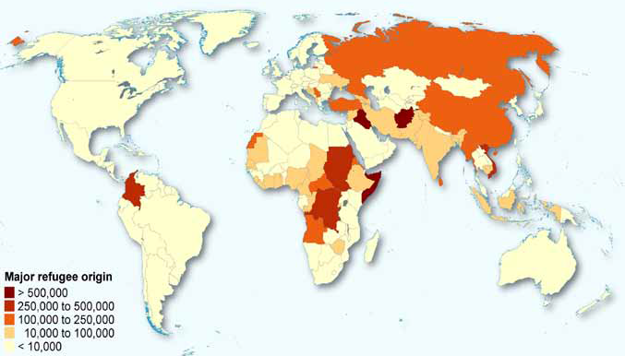
Mapping refugees

Slide 31
Mapping refugees
Identify the three countries where the largest number of refugees comes from.
Identify 3 countries where there are less than 10,000.
Can you identify any patterns regarding the areas where refugees come from?
What do you know about the context of areas where this is a high number of refugees fleeing (economic, social, political etc)?
Identify the location of the following countries who host many of the refugees (Pakistan, Syria, Ian, Germany, Jordan).
Explain why you think so many refugees end up in these countries.

Slide 32
Australia and refugees/asylum seekers
Australia’s refugee intake is very small compared to other countries.
Australia has offered a permanent home to more than 800,000 refugees and others in need of protection.

Slide 33
Refugees and asylum seekers In Detention
The policy of mandatory detention requires that people who are not Australia citizens and do not hold a valid visa must be detained. A person in immigration detention must either be given legal permission to remain in Australia or they will be removed.

Slide 34
Myths and facts about asylum seekers
‘Asylum seekers who arrive by boat are queue jumpers’
Applying offshore is the standard procedure for seeking protection because refugees are outside of their country of origin (or they are not classed as a refugee by definition).
The majority of the world’s refugees either return home when conditions improve or settle in their country of first asylum.

Slide 35
Myths and facts about asylum seekers
‘Asylum seekers who arrive by boat take places away from genuine refugees in overseas camps’
The perception is that there is a “queue” which onshore applicants are trying to evade, however, it is the Australian government’s policy which creates this perception. The policy states that if an onshore applicant is granted a Protection Visa, a place is deducted from the offshore program because the policy links the offshore and onshore places. Places are granted according to NEED, not waiting period.

Slide 36
Myths and facts about asylum seekers
‘Asylum seekers who arrive by boat present a security threat to Australia’
Refugees cannot seek asylum if they have committed war crimes, crimes against peace, crimes against humanity or any other serious non-political crime.

Slide 37
Myths and facts about asylum seekers
‘Mandatory detention of unlawful asylum seekers is an essential part of security’
Australia is one of a few nations which imposes mandatory detention on asylum seekers who arrive without visas. Australian practice also shows that asylum seekers allowed to live in the community while their claims are being processed are unlikely to run away as they have a vested interest in cooperating to gain full protection rights.

Slide 38
Myths and facts about asylum seekers
‘Tough border protection will stop people smugglers and prevent asylum seekers from making risky journeys’
Refugee flows are affected by war, unrest, violence and human rights abuses. Most people do not wish to leave. They do so as a last resort, to escape persecution and find safety and security for themselves and their family.

Slide 39
Myths and facts about asylum seekers
‘Australia is being swamped by asylum seekers. We take more than our fair share of refugees’
In 2013, Pakistan hosted 1.6 million refugees and asylum seekers compared to Australia’s 34,503.
Also, Australia received 0.34% of the global total of the 3,411,962 new asylum applications. That is a mere 10,000 or so…

Slide 40
Myths and facts about asylum seekers
‘Australia’s refugee program must have strict limits, otherwise we will end up hosting millions of refugees’
Worldwide, most common way of transport for asylum seekers is OVERLAND (between borders), NOT on planes or boats. Because of its geographical isolation, Australia is one of the hardest countries to reach. It is therefore unlikely that Australia will ever receive the large numbers of onshore asylum applications as other countries.

Slide 41
Myths and facts about asylum seekers
‘If someone can afford to pay a people smuggler thousands of dollars to travel to Australia, they cannot be a “genuine” refugee’
Economic status has nothing to do with refugee status. A refugee is someone who is in fear of being persecuted, it makes no difference if you are rich or poor, the point is they are at risk.
Many refugees who come to Australia are well educated and middle class and it is their education, profession or political opinions that draw the attention of the authorities who want to hurt them.

Slide 42
Myths and facts about asylum seekers
‘Refugee camps are perfectly safe. Why can’t these people just go there?’
Food and water supplies are unpredictable and refugees are often not allowed to leave or work outside the camp.
Violence, especially rape, is common.

Slide 43
Myths and facts about asylum seekers
‘Refugees don’t contribute to Australian society in any meaningful way’
Refugees are survivors.
They have courage, ingenuity and creativity.
That is the sort of contribution you can never have too much of.

Slide 44
Myths and facts about asylum seekers
‘Refugees and asylum seekers receive higher social security payments than Australian aged pensioners’
A refugee who has permanent residence receives the same social security benefit as nay other Australia under the same circumstances. Refuges apply through Centrelink and go through the same process as all applicants. There is no special allowance for being a refugee. Payments are calculated the same.
Asylum seekers are not eligible for financial support as they are not a permanent resident.

Slide 45
Refugees and asylum seekers In Detention
Asylum seekers who arrive are required to stay in detention well beyond their period of time it takes to gather basic information about an asylum claim, health, identity or security issues. Instead they must stay in detention until their asylum claim has been finalised or bridging visa has been issued.
Short answer question:
Is this a violation of their human rights according to the UDHR? Explain why.

Slide 46
Seeking refuge – what will you take with you?
You have half an hour before you must leave your home. Work out the list of things that you would like to take with you.
You are allowed to take one small suitcase with you. You cannot take anything that doesn’t fit.
After you have finalised your list, identify ONE item you would keep if you had to leave all else behind.
Write the situation you imagined which forced you to become a refugee and explain the items you have included on your list and why.

Slide 47
Children in detention
The issue of children in detention is an ongoing challenge for the Australian government.

Slide 48
Children In detention
Short answer research questions:
What are the negative psychological and physical health impacts of prolonged detention?
How have changes in policy impacted on the human rights of refugees and asylum seekers?
When did Australia change its policy on children in detention?
What was the main reason for changing the policy on children in detention?
What happens to children arriving in Australia illegally today?

Slide 49
Refugees and asylum seekers – the media
In small groups, read articles from television, newspaper or radio sources which mention refugees/asylum seekers and complete the table below.
Terminology - language used to describe refugees and asylum seekers
Refugees
Asylum Seekers

Slide 50
Review short answer questions
Do you agree that children should be detained? Why/why not?
Do you consider that people who arrive in Australia without a visa and seek asylum should be called ‘illegals’? Explain.
Do you believe that people commit an offence by arriving in Australia without permission and seeking asylum? Explain.
Do you agree that no refugee or asylum seeker should be subjected to any human rights violation in order to deter others from seeking asylum in Australia? Explain.
Do you agree that refugees and asylum seekers who pose no security or absconding threat should be detained? Explain.
Do you agree that all refugees should be treated equally regardless of how they arrive in Australia (boat or plane)? Explain.

Slide 51
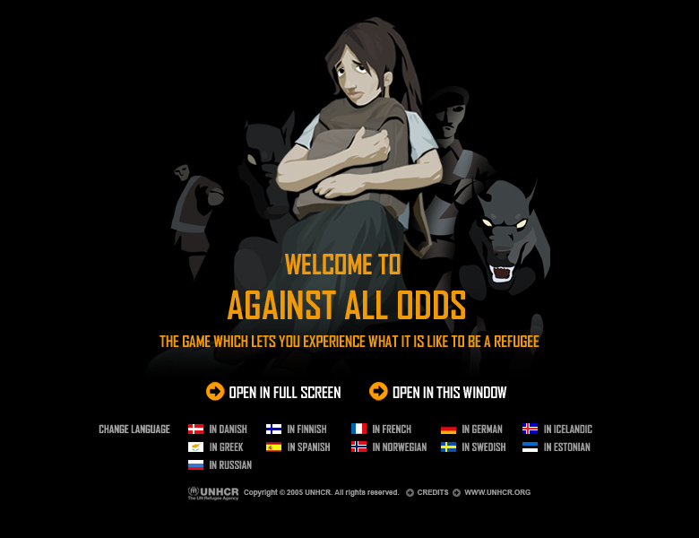
Interactive game
http://www.playagainstallodds.ca/

