Slide 1
Introducing Asia
Asia and Australia

Slide 2
What is Asia?
If I said the word ‘Asia’, what would you think of?
Activity –
Write down all the countries/cities that you can think of that are in Asia.

Slide 3
Where is Asia?
Look at the map.
What do you notice?
What sorts of countries are included in Asia?
Does it include all of the places that you wrote down?
Are there some parts of the region missing that you think should be there?
What does this map show us about the Asia region regarding size?

Slide 4
Where is Asia?
United Nations Geographical map of the Asia region. The world is divided in to 4 areas – Asia, Europe, American and islands.
Does it match the map we looked at earlier?
Why do you think this is so?

Slide 5
Asia and Australia.
What do you notice about this map?
What does it tell is about Australia’s place in the world?
Why do you think that is/is not Australia’s place in the world?

Slide 6
Australia and Asia
Trade
Policy – human rights (East Timor)
Aid to Asia – standards of living and sanitation
Education and job exchange

Slide 7
Aspects of Asia
Physical environment
Cultural environment
Social environment

Slide 8
Aspects of Asia – Physical Environment
Physical environments of the Asia region include:
Mountains
High points
Deserts
Ocean and inland water (valleys)
Fresh and salt water areas
Plateaus

Slide 9
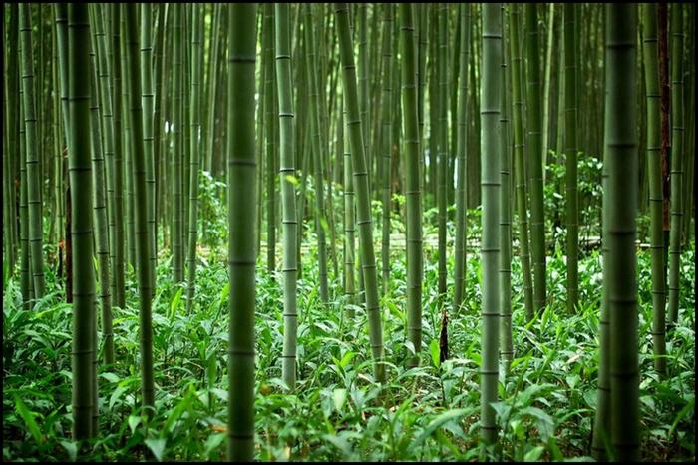
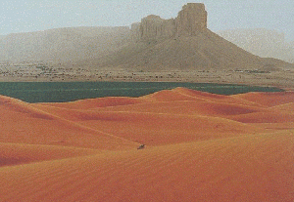
Aspects of Asia – Physical Environment

Slide 10
Aspects of Asia – Physical Environment
Climates are diverse in Asia:
Bitter cold
Hot, dry deserts
Humid
Monsoon season – strong winds

Slide 11
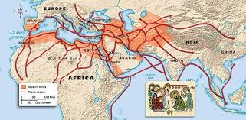
Aspects of Asia – Social Environment
Trade
Europe → Arabia → India = trade route
What was traded? Spices, cloths
and ceramics.
In land trade occurred using horses
camels, mules and by foot.

Slide 12
Aspects of Asia – Social Environment
Small communities – grow what you need to support your community.
Large communities – grow what you need to support your community and grow enough for trade (development of government to manage people).

Slide 13
Aspects of Asia – Cultural Environment
Languages –
Cultural identity
14 out of the 21 LARGEST languages are in Asia
Religion –
Important in Asia regions, gives purpose and behaviour (ethic/moral) code → in the early centuries and now. For example, the Kris for people in Indonesia (animism), Hinduism and Buddhism in India (Hindu caste system and Enlightenment), temples and stupes constructed in honour of religion and impacts on ceremonies, such as, weddings and funerals.

